Slide 1



KINGDOM OF MOROCCO
Mohammed VI Academy of Civil Aviation
Electrical, Electronics & Telecommunications Engineering
END OF STUDIES INTERNSHIP PROJECT
Secrecy Rate Maximization in RIS-Aided UAV ISAC Networks
AI-Driven Defense Against Jamming & Eavedropping
Presented by: Mahamadou DANSOKO
Supervisors
Pr. Jamal EL AOUFI (AIAC)
Pr. El Mehdi AMHOUD (UM6P)
Pr. Zouheir REZKI (UCSC)
Members of the Jury
Mrs. HALLOU AMAL (Member)
Mrs. HAJAR CHERRAD (President) Mrs. SOLDI KHADIJA (Member)
Defended: July 28th, 2025
Academic Year: 2024/2025
Notes:
FIRST SLIDE:
(Take a moment, stand confidently, smile, and make eye contact with the jury.)
"Good morning, esteemed members of the jury, respected supervisors, dear colleagues, and distinguished guests.
My name is Mahamadou Dansoko, and I am a final-year engineering student in Electrical, Electronics, and Telecommunications Engineering.
Today, I am honored to present the culmination of my end-of-studies internship project, conducted in collaboration with Mohammed VI Polytechnic University.
The title of my work is: 'Secrecy Rate Maximization in RIS-Aided UAV ISAC Networks.'
Essentially, this project tackles a critical and timely challenge: developing a robust, AI-driven defense against sophisticated jamming and eavesdropping threats in these next-generation wireless systems.
Before I delve into the details, I would like to take a moment to express my sincere gratitude.
First, to the members of the jury: thank you for your time, your expertise, and for providing me with this valuable opportunity to present my research.
A special and heartfelt thank you to my supervisors: my academic tutor, Mr. Jamal EL AOUFI, and my research supervisor, Professor El Mehdi AMHOUD. Your guidance, constant support, and invaluable insights have been absolutely instrumental throughout this entire project. I am deeply grateful for your mentorship.
And finally, thank you to everyone in the audience for being here today to listen.
With that, let us begin.

Slide 2


Contents
1
Introduction and Context
2
Problem Statement
3
Objectives and Contributions
4
System Model
5
Proposed Solutions
6
Simulation Results
7
Limitations
8
Conclusion and Perspectives
1
Notes:
SECOND SLIDE:
What to Say:
"Before we begin, let's quickly define the core technology at the heart of our research: ISAC. In traditional systems, sensing—like radar—and communication are done by two separate devices, using different hardware and different radio frequencies. This is inefficient."
(Gesture to the left panel.)
"The ISAC paradigm revolutionizes this by integrating both functions into a single platform. We use one signal to simultaneously communicate data and sense the environment. This leads to massive gains in efficiency, reduces hardware costs, and saves energy."
(Gesture to the right panel.)
"This fundamental concept of integration is the foundation of our work."

Slide 3
1
2
3
4
5
6
7
8
INTRODUCTION & CONTEXT
2
Defended: July 28th, 2025
Academic Year: 2024/2025
Academic Year: 2024/2025

Slide 4


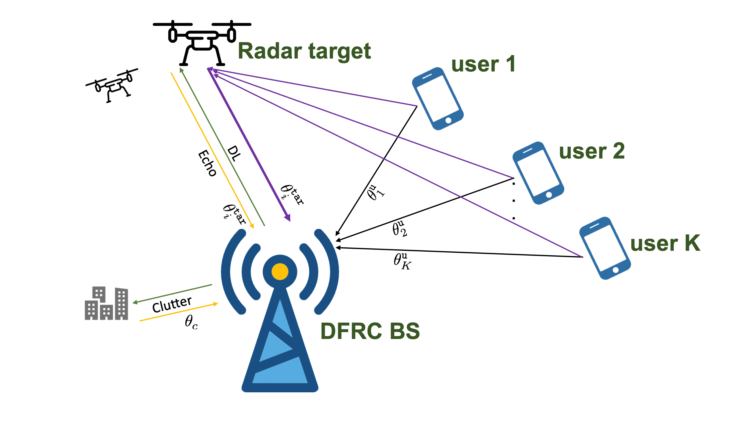


1
2
3
4
5
6
7
8
A Paradigm Shift: ISAC
Traditional Systems: The Old Way
The ISAC Paradigm: The Smart Way
Communication
Radar (Sensing)
✖️ Redundant Hardware: Separate systems for each function.
✖️ Wasted Spectrum: Frequencies are used inefficiently.
✖️ Higher Cost & Energy Use
✔️ Unified Platform: Sensing & communication in one device.
✔️ Shared Spectrum & Resources
✔️ High Efficiency & Lower Cost
3

Slide 5



A flexible and scalable alternative to permanent infrastructure.
1
2
3
4
5
6
7
8
UAVs as Mobile Infrastructure
The Mobile Infrastructure of NGNs
On-Demand Deployment:
Rapidly establish networks anywhere, anytime.
🛰️ Line-of-Sight (LoS) Links:
Fly above obstacles for ultra-reliable, high-quality connections.
Extended Coverage:
Provide connectivity in remote, hard-to-reach, or disaster-stricken areas.
💰 Cost-Effective:
A flexible alternative to building permanent ground infrastructure.
UAV Use Case in Precision Agriculture
4

Slide 6

1
2
3
4
5
6
7
8
In Summary
The NGNs & IoT Landscape
UAV Networks
Smart devices
The ISAC Paradigm
Energy efficiency
Central Hardware usage
The Security Challenges
Jamming
Eavesdropping
Spoofing & DoS
Other Challenges
Dynamic Environments
Complex Systems
5

Slide 7
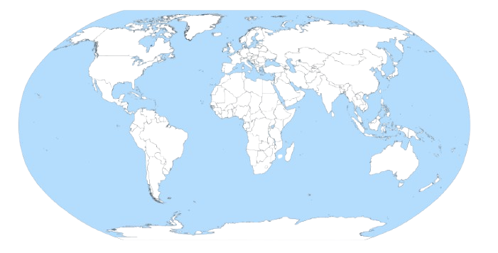




1
2
3
4
5
6
7
8
Context: An International Collaboration
GLOBAL PARTNERSHIP / ROLES:
UM6P & Santa Cruz: Leading the AI/DRL framework design and optimization theory.
EPFL & CentraleSupélec: Focused on hardware integration and the future physical testbed deployment.
MY ROLE:
Developing and validating the core AI-driven control and security engine
Through high-fidelity simulation, that the entire concept is feasible and highly effective
6

Slide 8



1
2
3
4
5
6
7
8
Host Organization
.
College of Computing:
Home of this Research
Excellence-driven Computer Science program.
Global academic partnerships to train top talent.
Identity & Missions:
Founded in 2013; inaugurated by His Majesty Mohammed VI in 2017.
Driving African development and national leadership through applied research and strategic partnerships.
Some of UM6P Different Departments
7

Slide 9
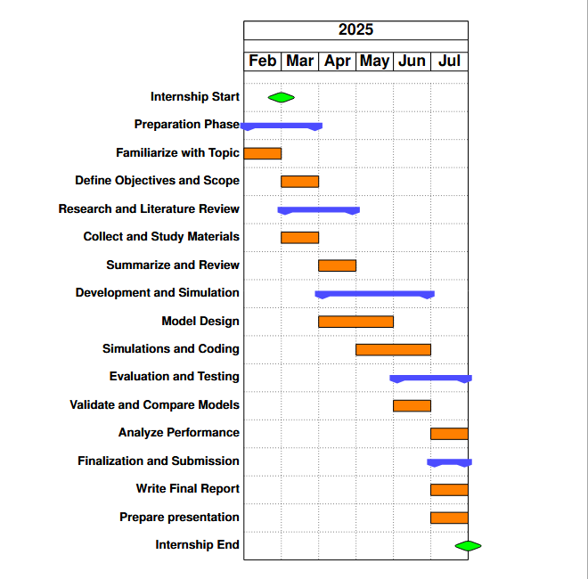
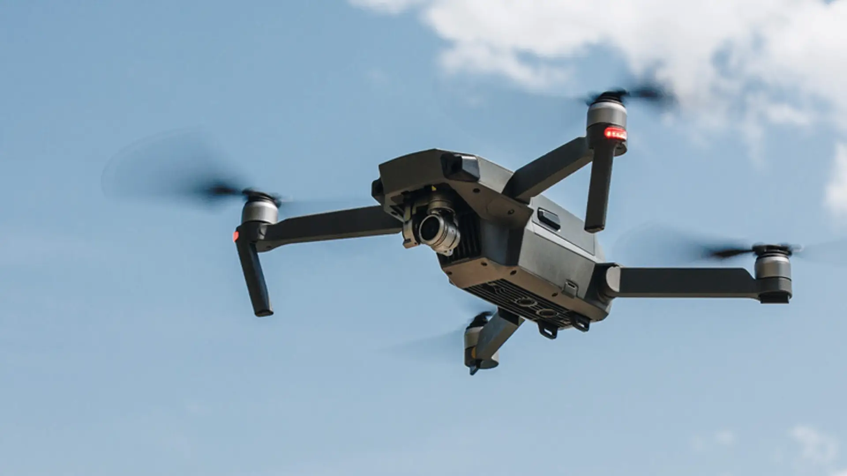
1
2
3
4
5
6
7
8
Internship Work Plan
8

Slide 10
1
2
3
4
5
6
7
8
PROBLEM STATEMENT
9
Defended: July 28th, 2025
Academic Year: 2024/2025

Slide 11

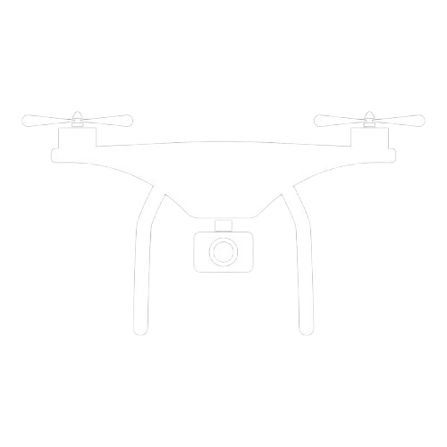
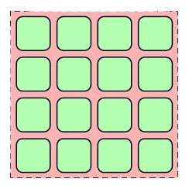

1
2
3
4
5
6
7
8
Problem Statement
Core research question
Why RIS-aided UAV-enabled ISAC is promising?
Dynamic Coverage & Control
Ultimate Efficiency
What challenges arise?
Extreme Vulnerability to Attack
Highly complex Optimization Task
“How can we design a secure, adaptive, and efficient RIS-assisted ISAC UAV system under jamming and eavesdropping threats?”
10

Slide 12


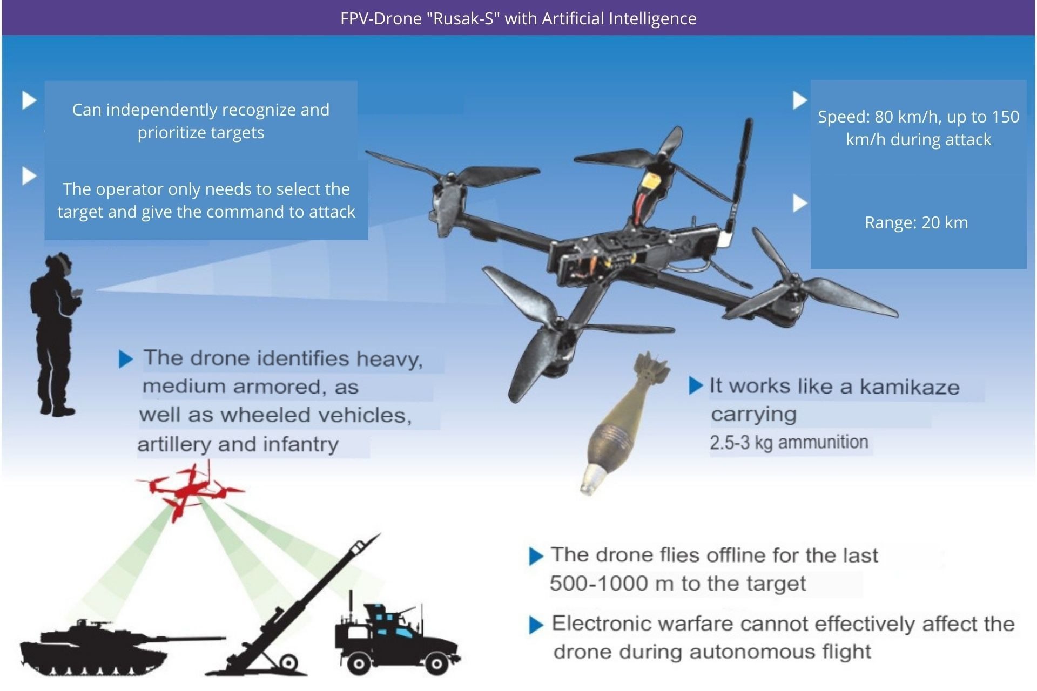
1
2
3
4
5
6
7
8
Socio-economical Impact & Applications
Public Safety & Disaster Management
Smart Agriculture & Rural Dev
Inspection & Security
11

Slide 13
1
2
3
4
5
6
7
8
OBJECTIVES & CONTRIBUTIONS
12
Defended: July 28th, 2025
Academic Year: 2024/2025

Slide 14



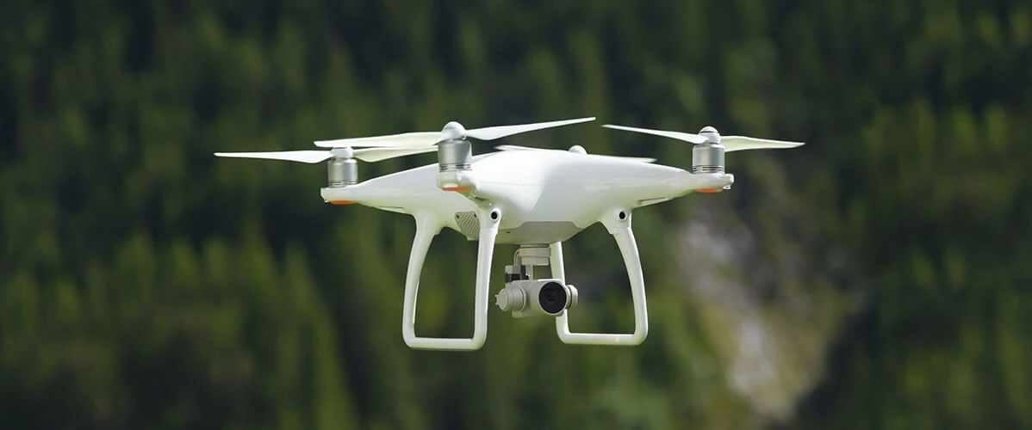
1
2
3
4
5
6
7
8
Objectives
Develop a Unified Optimization Framework
Trajectory Optimization / DFRC-BF
RIS’s Phase Shift /CUs’ Scheduling
Master the Security-Performance Trade-off
Secrecy Rate Maximization / Sensing SNR Guarantee
Proactive Jamming Defense / Eavesdropping Mitigation
Design an Intelligent and Adaptive Control Strategy
Deep Reinforcement Learning / Real-Time Control
Model-Free Adaptation / Autonomous Policy Generation
13

Slide 15




1
2
3
4
5
6
7
8
Contributions
AI-Driven Optimization Framework
Advanced Simulation & Adaptation Strategy
Novel System Architecture
Validation in Realistic Scenarios
DRL for Non-Convex Optimization
Autonomous Real-Time Control
High-Fidelity OpenAI Gym Environment.
Practical Offline-to-Online Strategy
Unified ISAC, Jamming & RIS Design
Proactive Physical-Layer Defense
Rigorous Adversarial Testing
Proven Robustness Under Blockage
14

Slide 16
1
2
3
4
5
6
7
8
SYSTEM MODEL
15
Defended: July 28th, 2025
Academic Year: 2024/2025

Slide 17
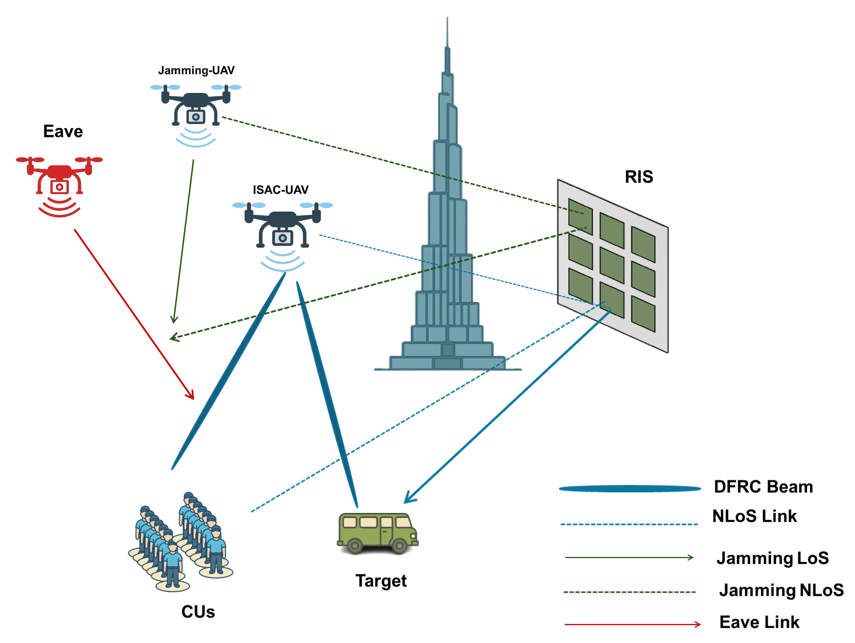
1
2
3
4
5
6
7
8
System Model
RIS-aided UAV-enabled ISAC Framework
16

Slide 18
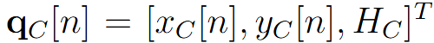
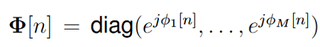
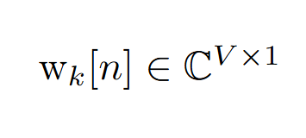
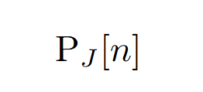
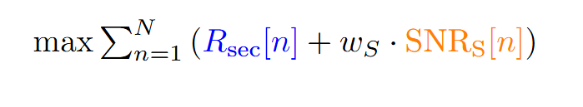
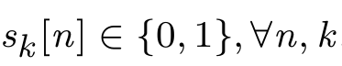
1
2
3
4
5
6
7
8
Mathematical Formulation
Optimization Variables
Objective
(1)
maximize weighted sum of secrecy rate and sensing SNR
(2)
(3)
(4)
(5)
Constraints
The Fundamental Challenge
UAV Kinematics (max speed, boundaries)
Transmit & Jamming Power Limits
Minimum QoS for Users (communication rate)
Minimum Sensing SNR for Target
This problem is highly non-convex. The variables are intricately coupled, making it impractical to solve with traditional optimization methods.
17

Slide 19
1
2
3
4
5
6
7
8
PROPOSED SOLUTIONS
18
Defended: July 28th, 2025
Academic Year: 2024/2025

Slide 20
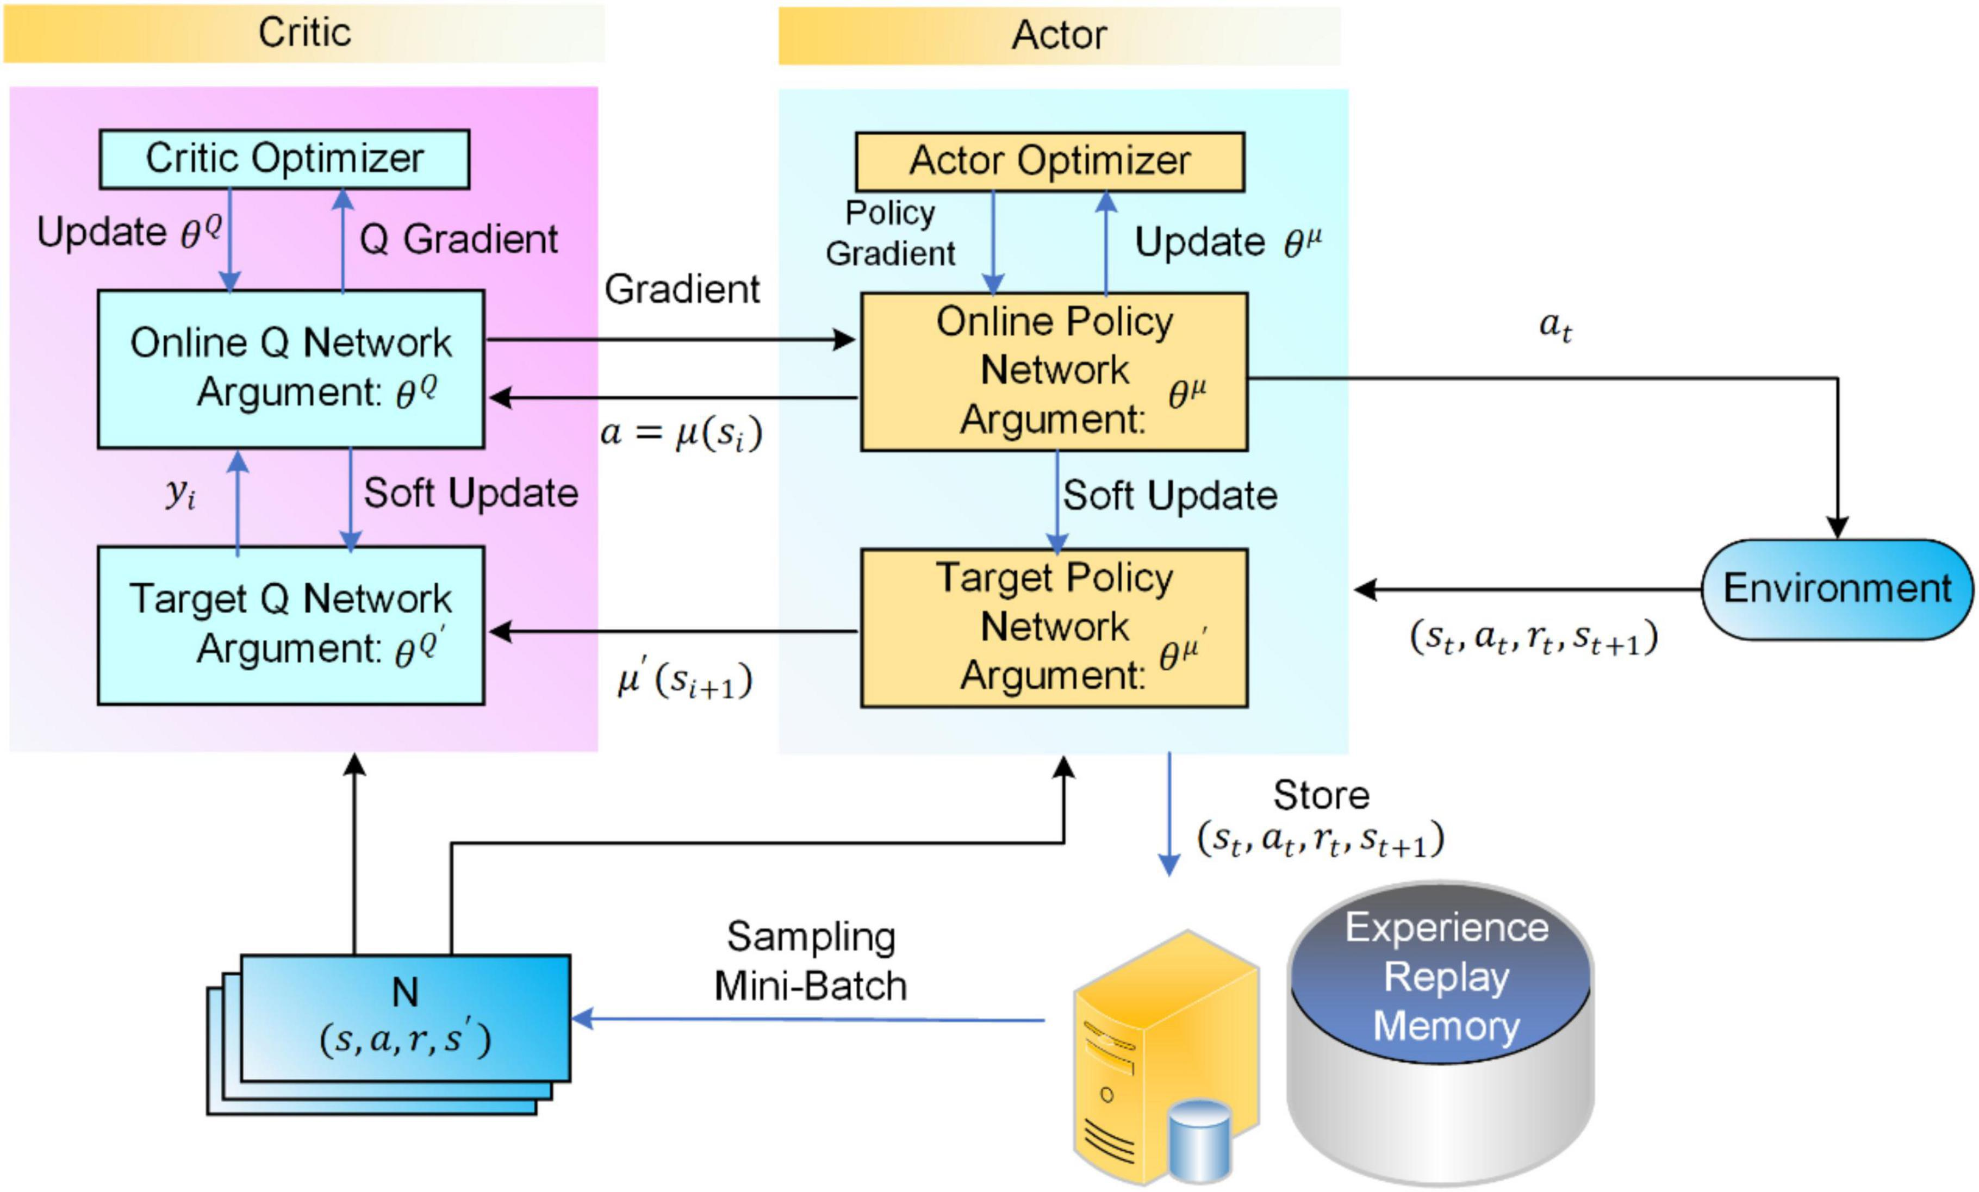
1
2
3
4
5
6
7
8
Proposed AI Framework
Why DRL ?
Handles Complex, Non-Convex Problems
Learns Directly from Experience (Model-Free)
Why DDPG Specifically ?
Needed for Continuous Control (UAV speed, RIS phase, etc)
Best for Precision + Smooth Policy
DDPG Algorithm
19
Notes:
NINETH SLIDE:
"This diagram shows how our AI agent learns. It's a DDPG agent, which has two main parts: an Actor that acts, and a Critic that judges.
(Point to the Actor Block)
First, the Actor observes the environment's current State and decides on an Action
(Point to the Environment and Replay Memory)
The Environment responds with a Reward, and this entire experience—the state, action, and reward—gets stored in the Experience Replay Memory.
(Point to the Critic Block)
Now for the learning part. We randomly sample a batch of old memories. The Critic then looks at these past experiences and judges how good the Actor's decisions were.
(Point to the arrow from Critic to Actor)
Based on this judgment, the Critic provides feedback to the Actor.
(Gesture briefly to the Target Networks)
We also use Target Networks to keep this whole process stable.
(Summarize with a concluding gesture to the whole diagram)
So, in essence: the Actor acts, the Critic critiques, and the agent learns by replaying its memories.
Explaination of the rest of the DDPG
Team Actor: The Decision-Maker
1. Online Policy Network (θ^μ)
Its Job: This is the Actor's brain. It's the active decision-maker.
What it does: It looks at the current state of the environment and decides on the best action to take right now.
2. Target Policy Network (θ^μ')
Its Job: This is the Actor's stable, slow-moving twin.
What it does: It's an older, more stable copy of the Actor's brain. Its purpose is to provide a consistent target for the Critic to evaluate, which prevents the learning process from becoming unstable.
3. Actor Optimizer
Its Job: This is the learning engine for the Actor.
What it does: It takes the feedback from the Critic and uses it to update the Actor's brain (the Online Policy Network), nudging it to make better decisions in the future.
Team Critic: The Judge
4. Online Q Network (θ^Q)
Its Job: This is the Critic's brain. It's the active "judge."
What it does: It evaluates the action taken by the Actor in a given state and outputs a score (the Q-value). It answers the question: "How good was that move?"
5. Target Q Network (θ^Q')
Its Job: This is the Critic's stable, slow-moving twin.
What it does: Just like the Actor's target network, this provides a stable benchmark. It's used to calculate how "surprising" the Critic's judgment was, which is crucial for training the Critic to be more accurate.
6. Critic Optimizer
Its Job: This is the learning engine for the Critic.
What it does: Its goal is to make the Critic a better judge. It compares the Online Q Network's score to the more stable target value and updates the Critic's brain to reduce the error, making its future evaluations more reliable.
Simple Summary:
"In short, for both the Actor and the Critic, the 'Online' networks are the active players, the 'Target' networks provide stability for learning, and the 'Optimizers' are the engines that actually update the networks to make them smarter over time."

Slide 21



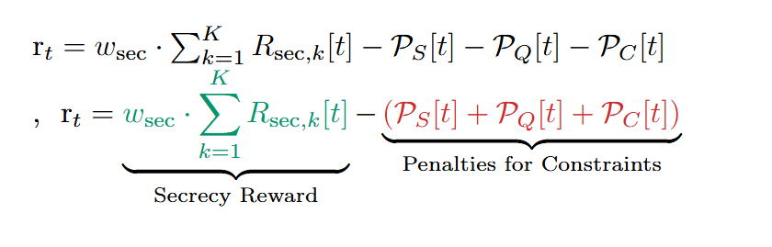

1
2
3
4
5
6
7
8
DRL Model Structure
State Space: The Agent's Perception
Action Space: The Agent's Control Levers
Positions: UAVs, Users, Target, Eve
Channel Information (CSI): All wireless link qualities
System Status: RIS config, Power, Time remaining
UAV Trajectory: Velocities & Directions
RIS Configuration: All phase shifts
Resource Allocation: Beamforming and Jamming Power
Reward Function: The Guiding Signal
Constraint Violation
Objective Achievement
Reward = Positive Incentive - Penalties
20
Notes:
Ps[t] : Penalty for Sensing Failure
What it stands for: Penalty for Sensing (SNR).
What it is: This is a penalty that gets applied if the signal-to-noise ratio for the sensing target falls below a required minimum threshold.
Purpose: This ensures that the UAV cannot sacrifice its primary sensing mission. It forces the agent to always keep the target "in view" with a strong enough signal, even while dealing with security threats.
In simple terms: It's the penalty for "losing sight of the target."
Pq[t] : Penalty for QoS Failure
What it stands for: Penalty for Quality of Service (QoS).
What it is: This penalty is triggered if the communication data rate for any of the legitimate communication users drops below their minimum required threshold.
Purpose: This guarantees that the legitimate users are always being served properly. It prevents the agent from, for example, focusing so much on jamming the eavesdropper that it forgets to communicate effectively with its own users.
In simple terms: It's the penalty for "providing bad service to a user."
Pc[t] : Penalty for Collision / Constraint Violation
What it stands for: Penalty for Collision / physical Constraints.
What it is: This is the most critical safety penalty. It is a very large negative reward that is applied if the UAVs violate fundamental physical rules. This typically includes:
Collision Avoidance: The distance between the ISAC-UAV and the Jamming-UAV becomes less than a minimum safe distance.
Boundary Violation: A UAV flies outside of its designated operational area.
Kinematic Limits: A UAV attempts to exceed its maximum possible speed.
Purpose: To ensure the system operates safely and realistically. This penalty is usually much larger than the others because these violations are catastrophic.
In simple terms: It's the severe penalty for "crashing the drone" or "flying out of bounds."
How They Work (The Mechanism)
You can add this final point for clarity:
"Each of these penalty functions is designed to be zero when the constraint is met, and a large positive number when the constraint is violated. By subtracting these from the reward, we strongly discourage the agent from ever entering these undesirable states, teaching it to find a solution that is not only high-performing but also safe and feasible."

Slide 22
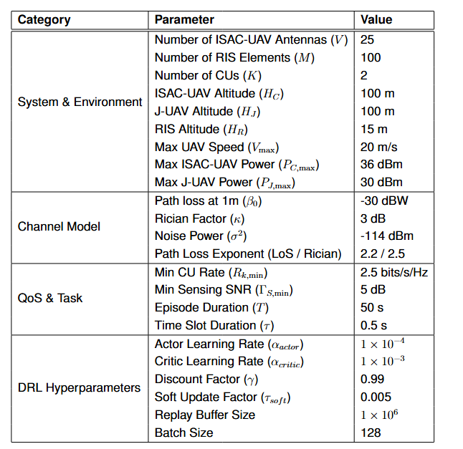
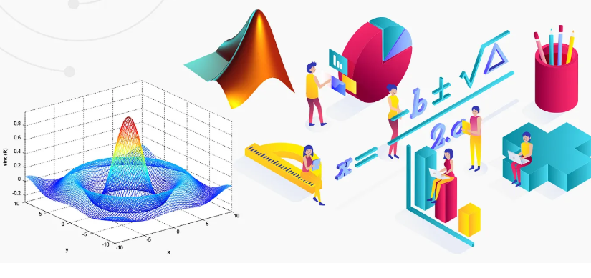
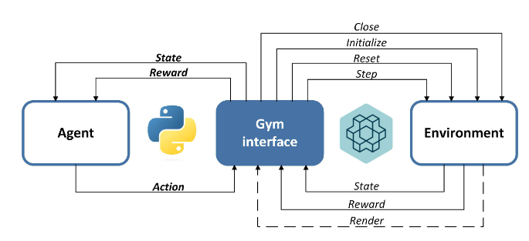

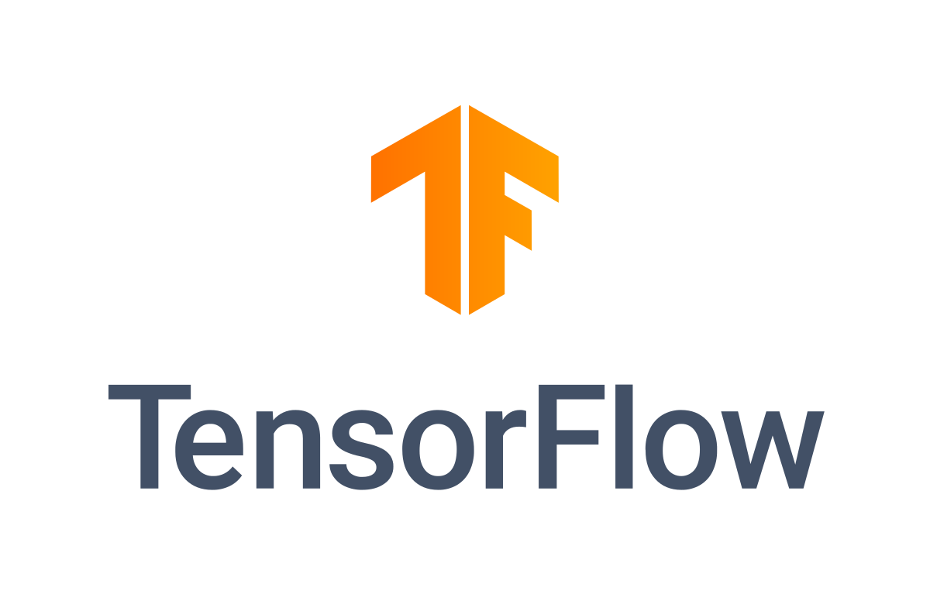
1
2
3
4
5
6
7
8
Tools & Simulation Parameters
SimulationTools
Our Simulation Variables
21

Slide 23
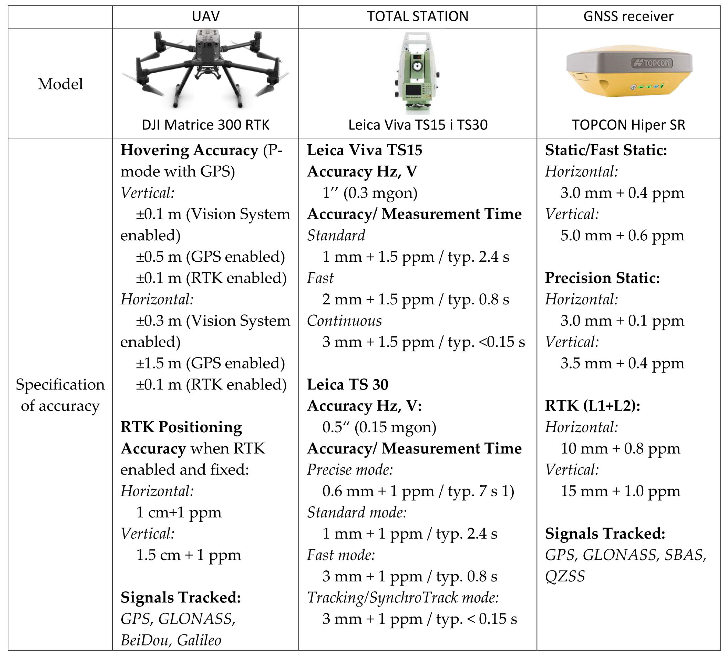
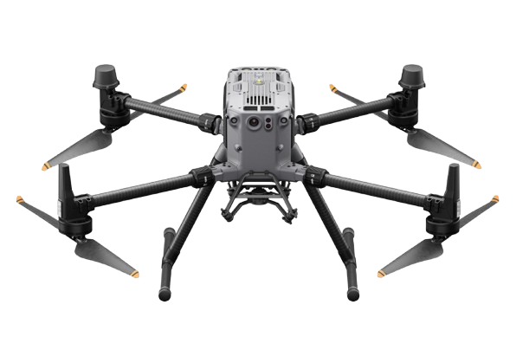
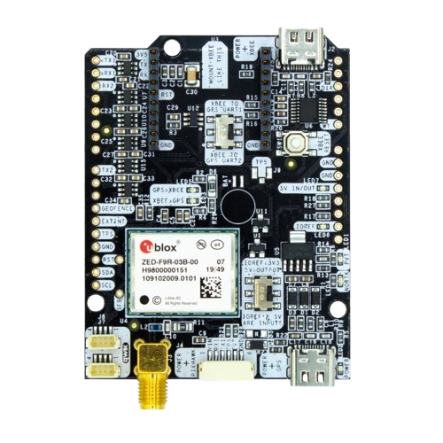
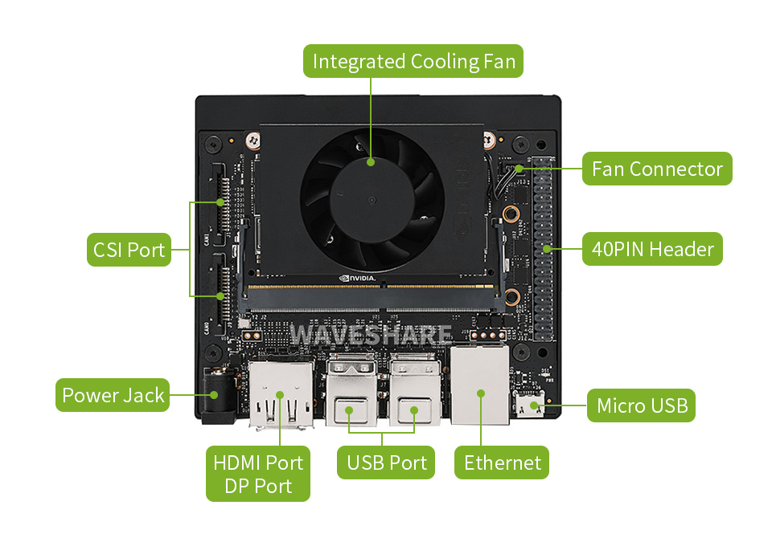
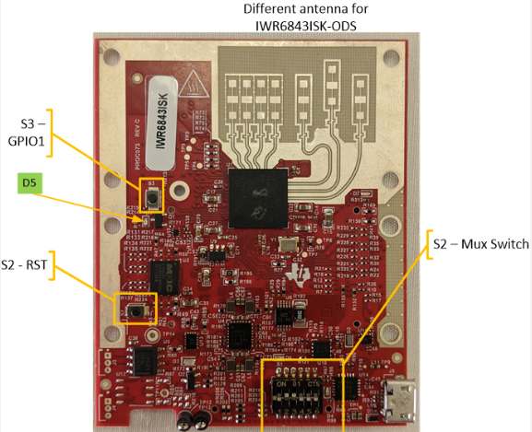
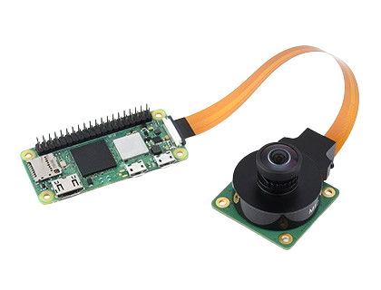
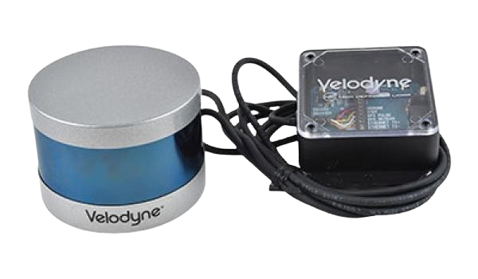
1
2
3
4
5
6
7
8
Prototype Hardware Components
DJI 300 RTK
Flight Controller
Onboard AI Computer
mmWave Radar Sensor
Optical Camera
LiDAR Sensor
22

Slide 24
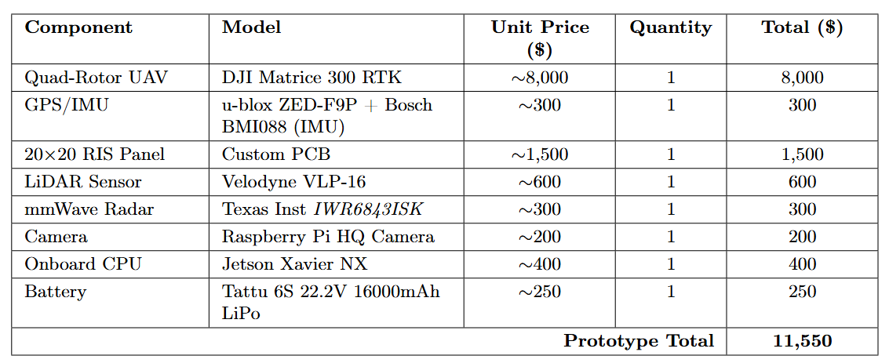
1
2
3
4
5
6
7
8
Estimated Budget
23

Slide 25


1
2
3
4
5
6
7
8
Deployment Roadmap &
Technology Readiness Level (TRL)
Phase | Timeline | Status | Status
Pahse 1 | System Modeling & DRL Simulation
Pahse 2 | Hardware Stup & Lab Prototype
Pahse 3 | Field Testing & Performance Validation
Pahse 4 | Industrial Trasnfert / Applied Use |  | Future Goal
Completed
In Progress
Planned
24

Slide 26
1
2
3
4
5
6
7
8
SIMULATION RESULTS
25
Defended: July 28th, 2025
Academic Year: 2024/2025

Slide 27
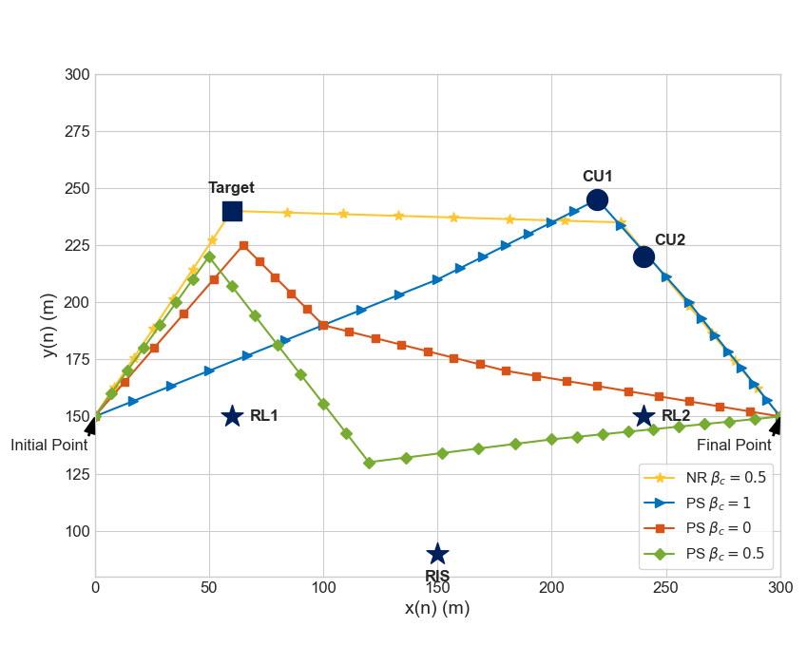
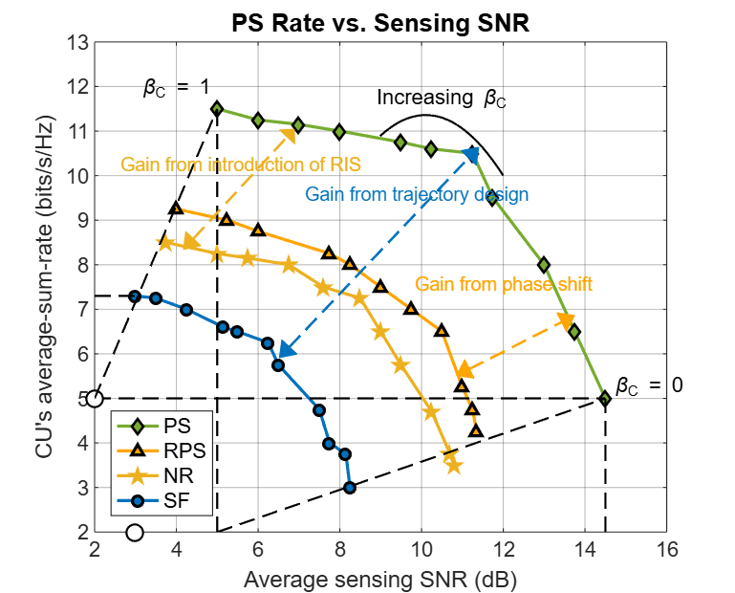
1
2
3
4
5
6
7
8
MATLAB Simulation Results
UAV Trajectories
26

Slide 28
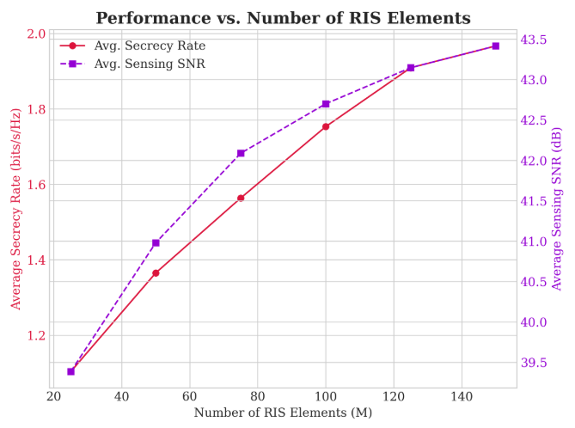
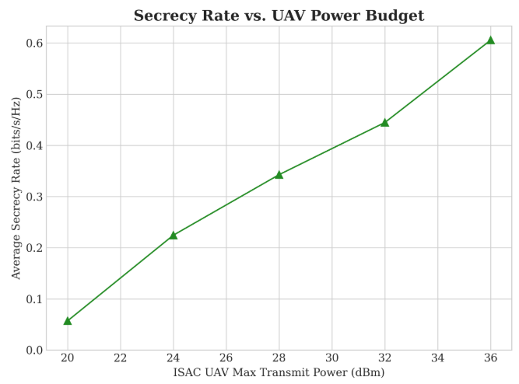

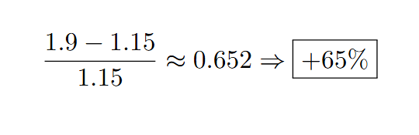

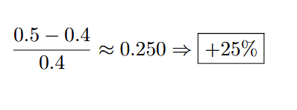

1
2
3
4
5
6
7
8
PYTHON Simulation Results
🔋
27
Gain ≈ +4 dB
+10% total energy for communication

Slide 29
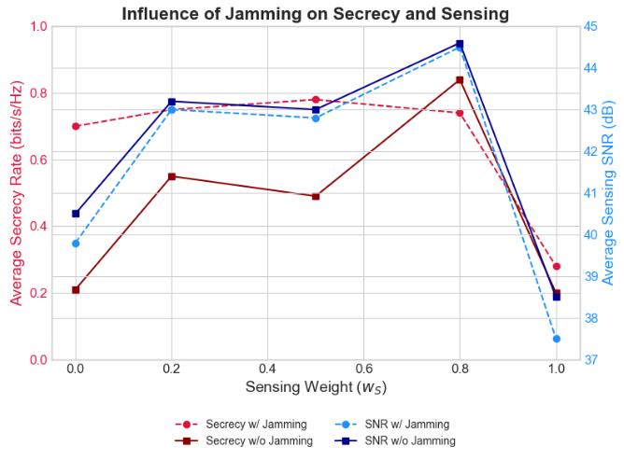
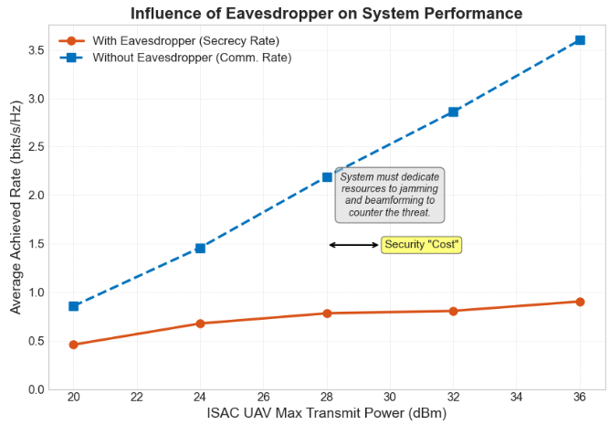
1
2
3
4
5
6
7
8
PYTHON Simulation Results
28

Slide 30
1
2
3
4
5
6
7
8
Performance vs. Resource Efficiency
Metric | Gain | Required Resource
🔐 Secrecy Rate | +65% | 140 RIS elements
📶 SNR Improvement | +4 dB | Same 140 RIS elements
🔋 Energy Consumption | +25% gain in secrecy | +3 dB (double Tx power)
🧱 Hardware Complexity | Moderate | Small form RIS (20×20)
💰 Budget Efficiency | High | ≤ 12k $ for full setup
Our system delivers strong physical-layer security and sensing improvements with minimal increases in power and hardware footprint, making it ideal for real-world UAV deployments.
29

Slide 31




1
2
3
4
5
6
7
8
Benchmark & Baselines
Capability | Our Framework | No RIS | No Jamming | Static UAV | Traditional Opt.
Adaptive Trajectory
Intelligent RIS Control
Active Jamming Defense
Real-Time Dynamic Opt.
Handles Non-Convexity
Result: High Secrecy & QoS
30

Slide 32
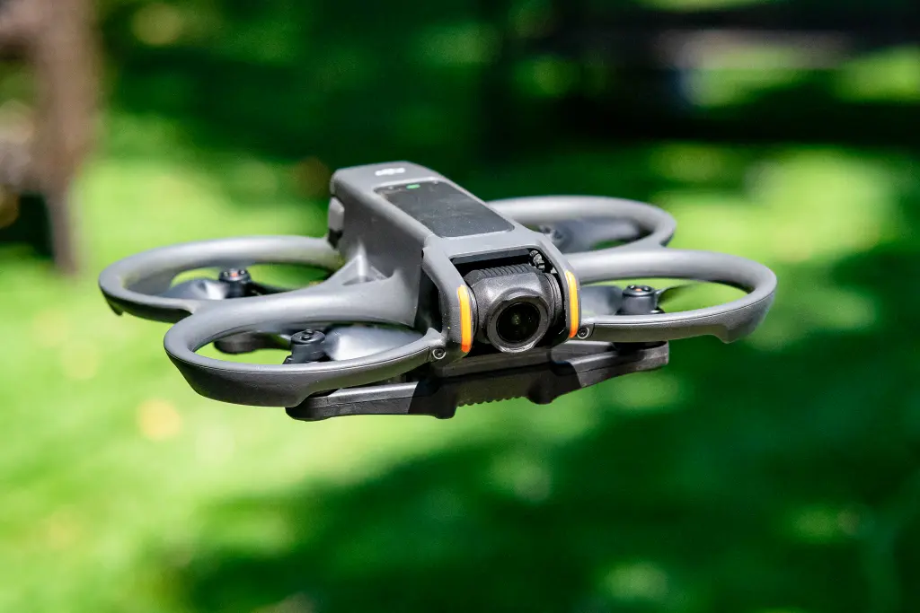
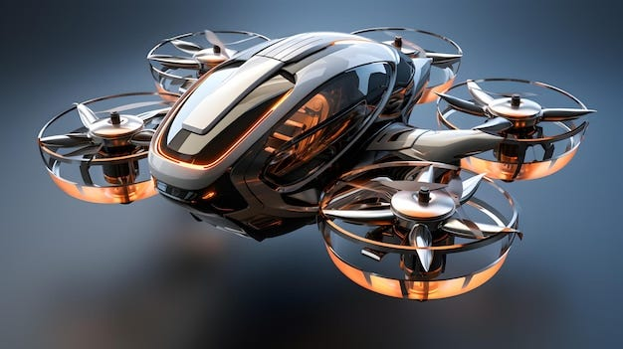
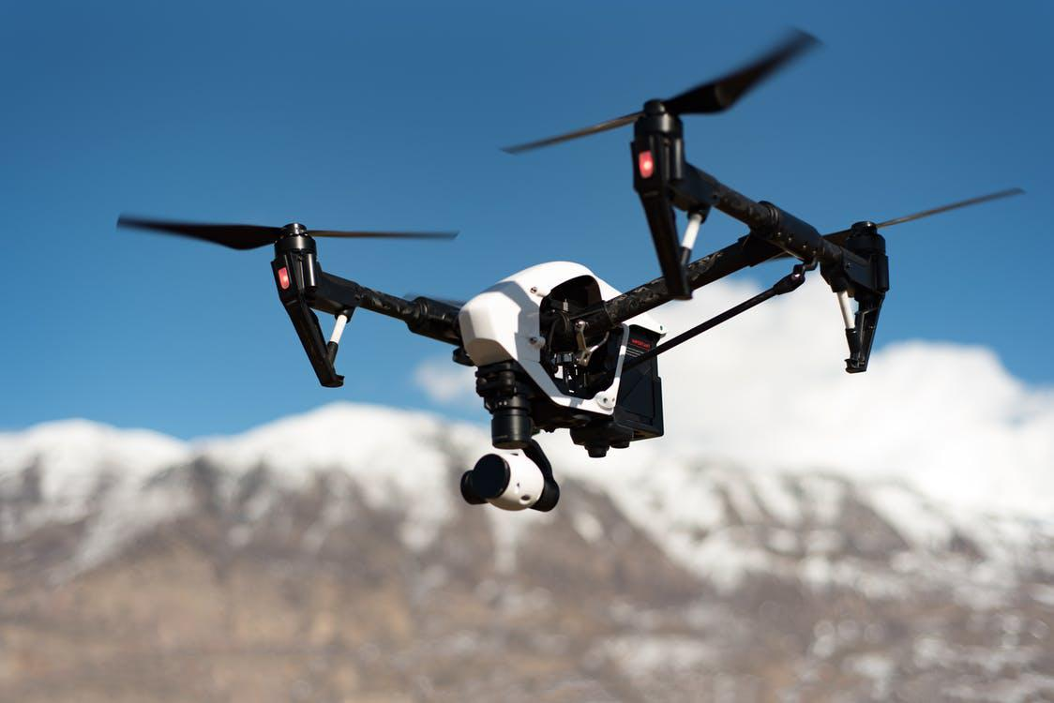
1
2
3
4
5
6
7
8
Interpretation of Findings
RIS boosts sensing and helps in beamforming trade-offs
DRL leads to adaptive, high-performance control
Jamming UAV significantly improves secrecy
Offline training increases deployability
31

Slide 33
1
2
3
4
5
6
7
8
LIMITATIONS OF OUR FRAMEWORK
32
Defended: July 28th, 2025
Academic Year: 2024/2025

Slide 34
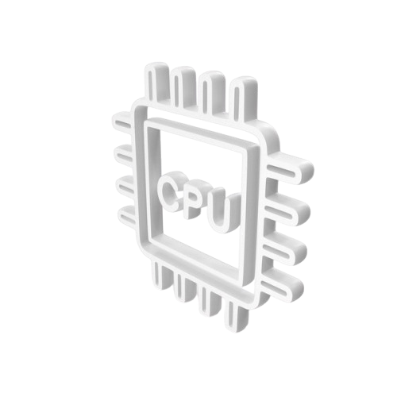





1
2
3
4
5
6
7
8
Limitations
Perfect CSI
Offline Training
Target & CUs Scenario
Fixed Altitude UAVs
No Hardware
New scenarios with federated and transfer learning.
Complex multi-target and multi-user environments
3D trajectory optimization for enhanced performance and evasion.
Physical UAV-RIS testbed to bridge the sim-to-real gap..
Uncertain or delayed channel information
33

Slide 35
1
2
3
4
5
6
7
8
CONCLUSION & PERSPECTIVES
34
Defended: July 28th, 2025
Academic Year: 2024/2025

Slide 36

1
2
3
4
5
6
7
8
Conclusion
Summary of Contributions
AI-driven Secure ISAC UAV Architecture
Proposed a novel, AI-driven secure ISAC architecture.
Successfully navigated the core secrecy vs. sensing trade-off
Integrated a cooperative jammer for proactive defense.
Demonstrated significant performance gains against threats.
DRL (DDPG) Framework
Simulation & Benchmark
Confirmed DRL as an effective solution for real-time, non-convex problems.
Enabled autonomous control in dynamic and adversarial environments.
Rigorously validated in a custom, high-fidelity simulation.
Demonstrated clear superiority over existing benchmarks in security and performance.
35

Slide 37






1
2
3
4
5
6
7
8
Perspectives
Real-World Experimentation
Hardware-in-the-Loop Simulation
Federated or Transfered Learning
Energy-Efficient Learning
Robustness to Imperfect CSI
Multi-Target & Multi-User ISAC
36

Slide 38
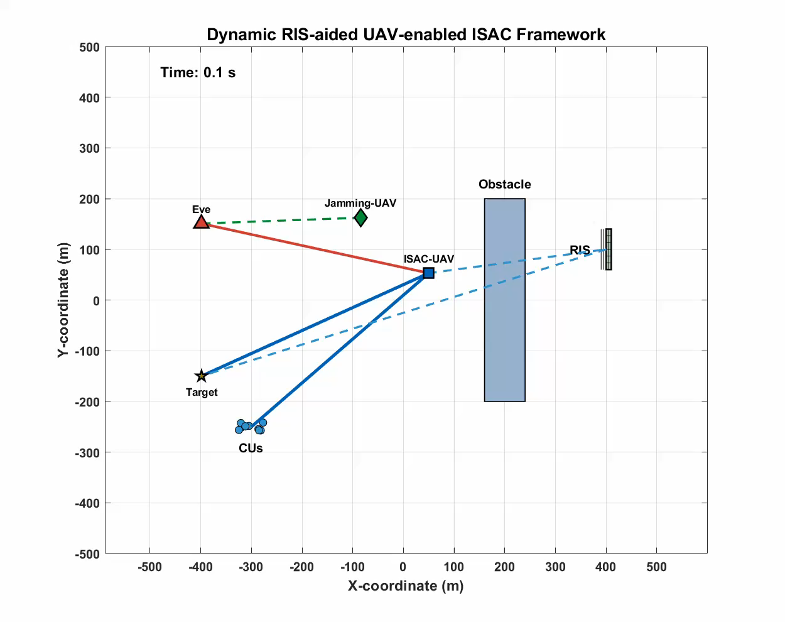

37

Slide 39
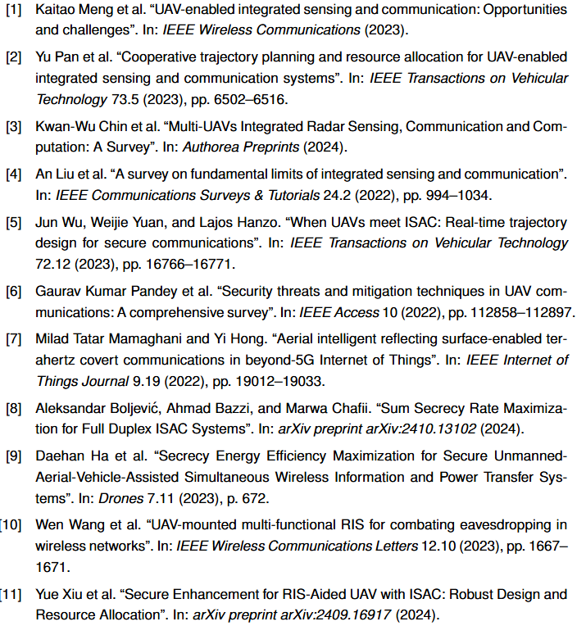
Bibliography
38

Slide 40
THANK YOU
39

Slide 41
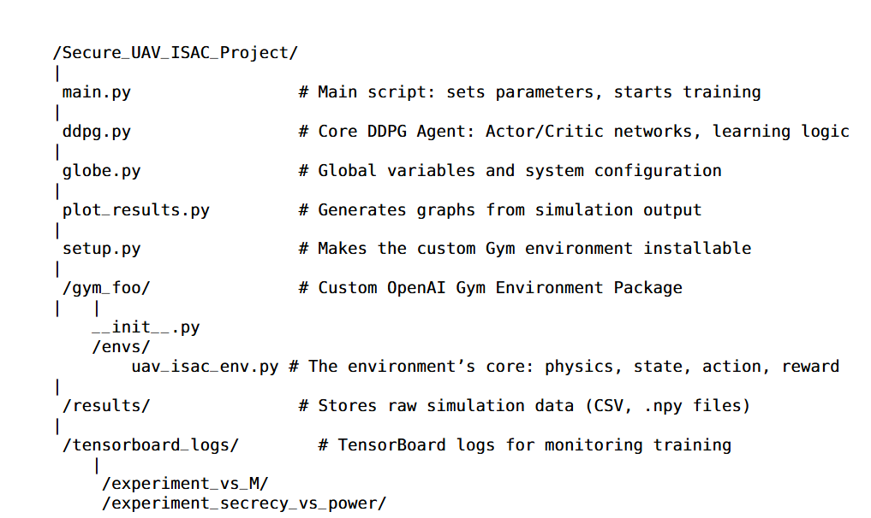
ANNEXE
Software Arcitecture and Project File Structure
Key Technologies Used:
Python 3.13.1
TensorFlow / PyTorch
OpenAI Gym
NumPy
Matplotlib
40

Slide 42
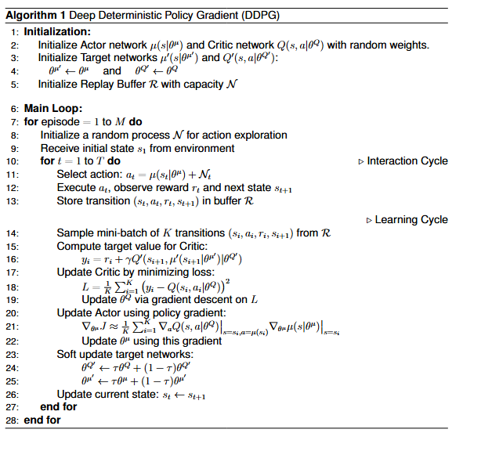
41
Notes:
Pseudo-Code:
"Certainly. First, we initialize four networks: an active Actor and Critic, and a stable Target Actor and Critic. We also create a Replay Buffer to store memories."
"Then, we start the main loop. In each step, the Actor chooses an action, we execute it in the environment, and we store the entire experience—state, action, reward, and next state—in the Replay Buffer."
"Now for the learning. We sample a random batch of memories from the buffer."
"We use these memories to first train the Critic. The Critic learns to become a better judge by comparing its predictions to a more stable 'target' value calculated using the Target Networks."
"Once the Critic is updated, we then train the Actor. The Actor's goal is simple: take actions that the Critic will score highly. So we update the Actor based on the Critic's feedback."
"Finally, we do a 'soft update': we slowly mix the weights from our main networks into the Target Networks. This is the key to keeping the whole process stable."

